Slide 1
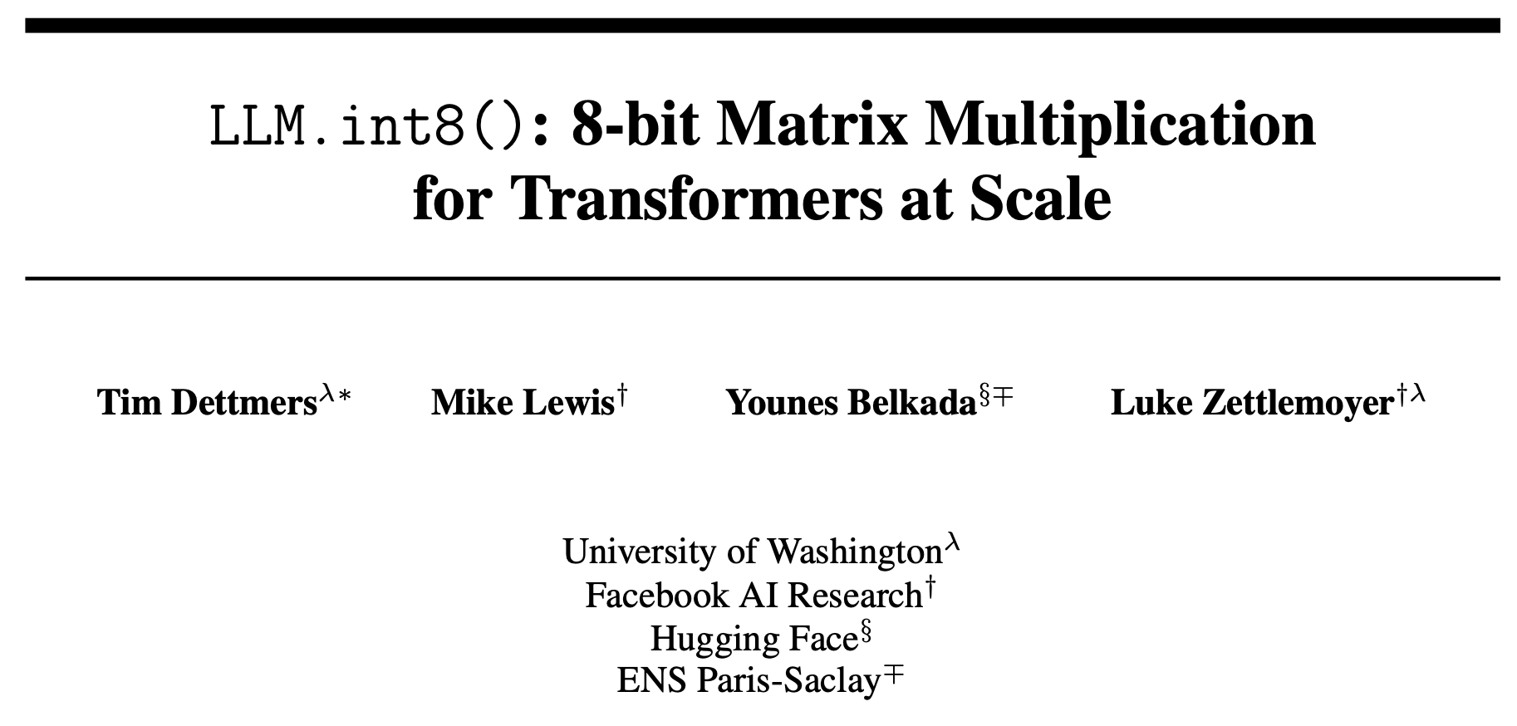

Slide 2
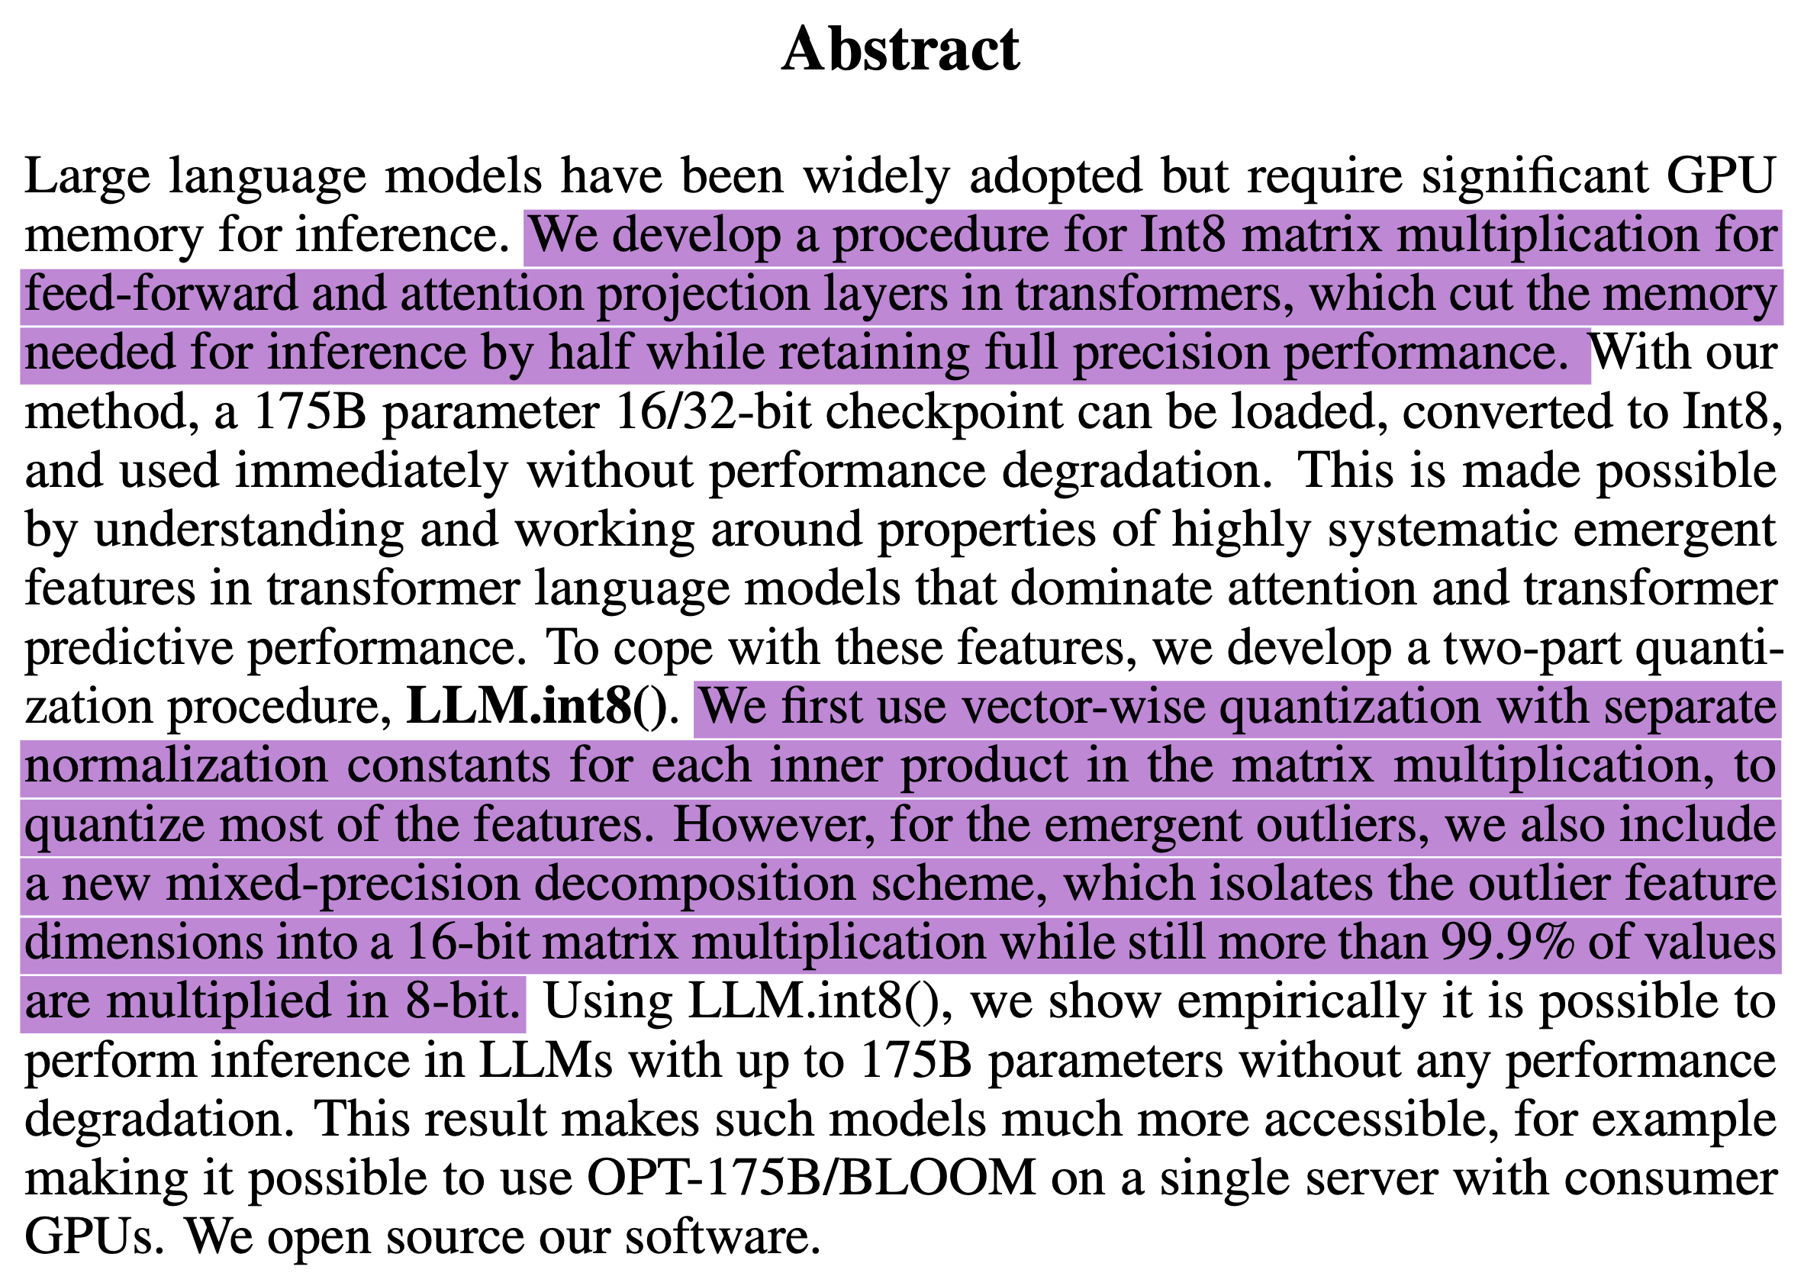

Slide 3
Motivation
Matrix multiplication operations
Are responsible for 95% of consumed parameters and
65-85% of all computation
Quantization is poorly understood
Behavior of quantized models changes considerably between small and large transformers

Slide 4
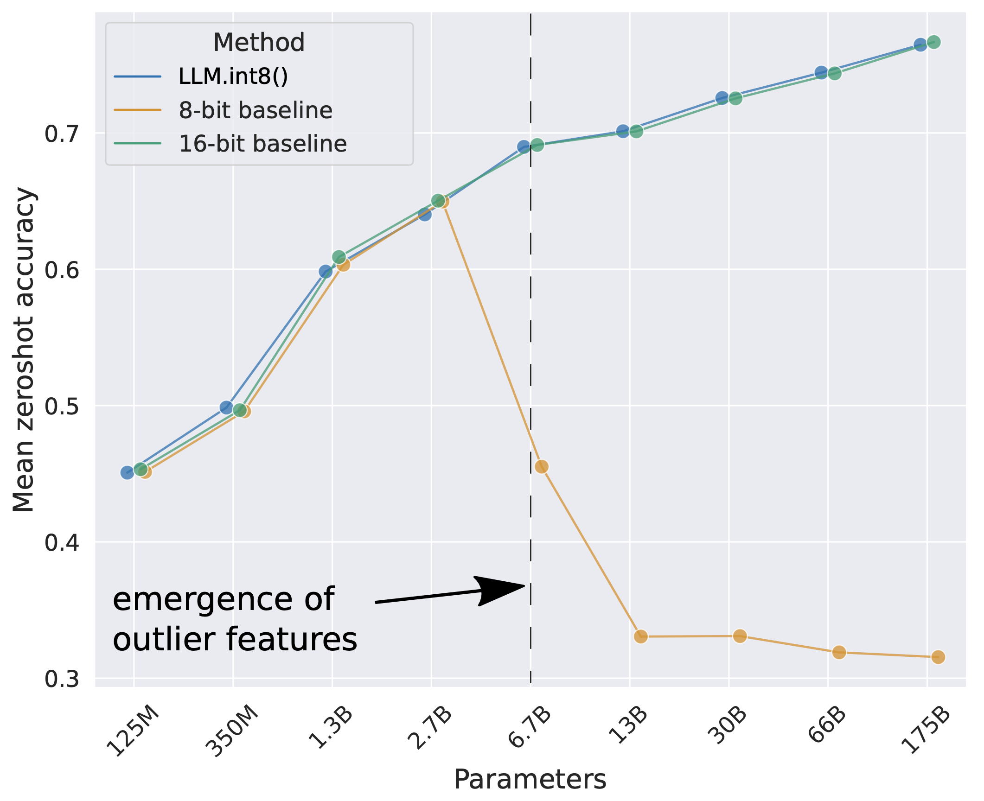
Motivation

Slide 5
Hint
Large features with magnitudes up to 20x larger than in other dimensions first appear in about 25% of all transformer layers and then gradually spread to other layers as we scale transformers to 6B parameters.
These outliers are highly systematic: at the 6.7B scale, 150,000 outliers occur per sequence, but they are concentrated in only 6 feature dimensions across the entire transformer.

Slide 6
Background on Quantization
(Quantization = converting floating point values to 8-bit integers)

Slide 7
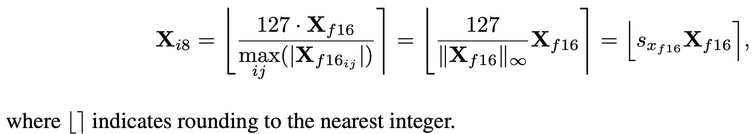
Absmax Quantization

Slide 8
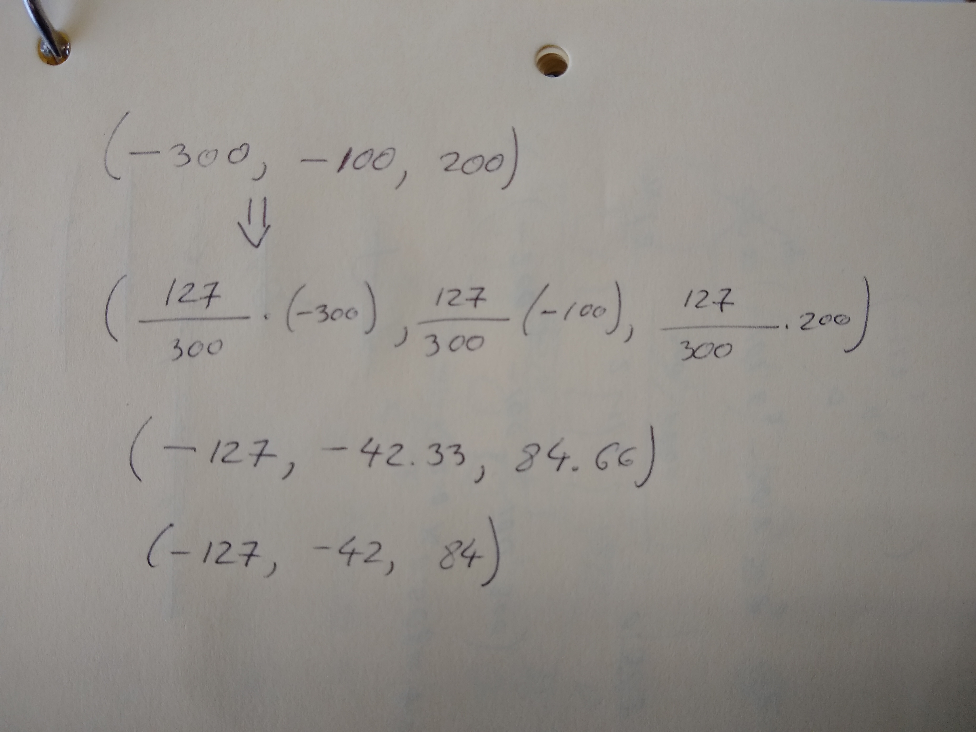
Absmax Quantization

Slide 9
Absmax Quantization Problems
It’s possible that it doesn’t use the whole [-127, 127] range, e.g., ReLU uses only [0, 127].
Sensitive to outliers. Why?

Slide 10
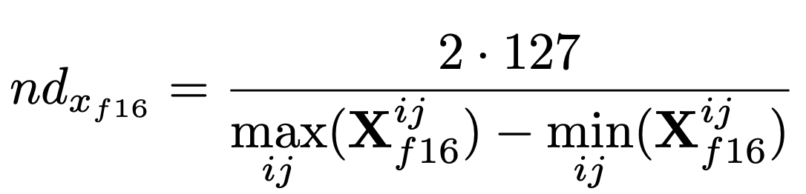
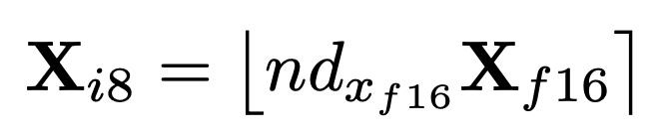
Zeropoint Quantization

Slide 11
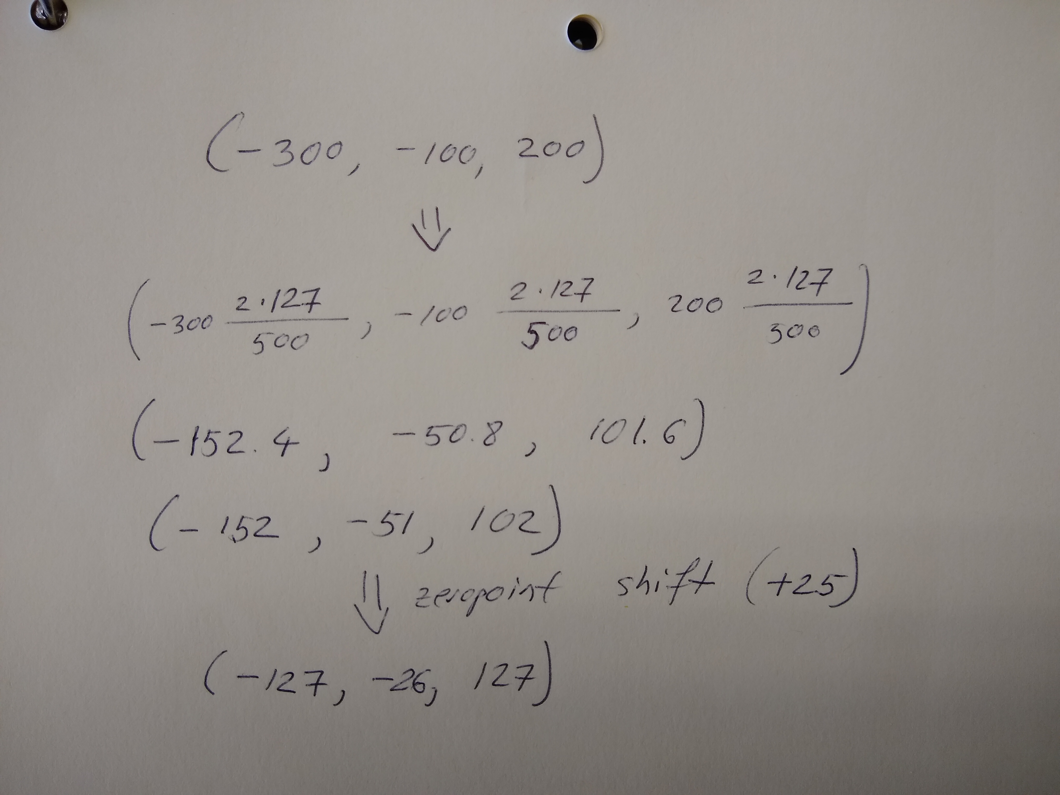
Zeropoint Quantization

Slide 12
Zeropoint Quantization Problems
More costly to compute
Sensitive to outliers

Slide 13
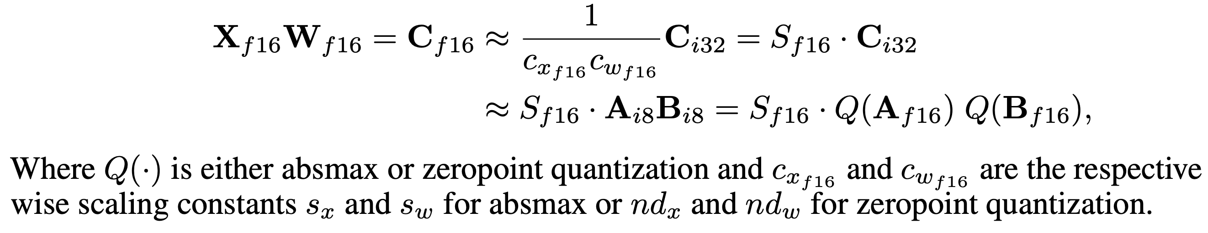
Int8 Matrix Multiplication

Slide 14
Quantization Background
For more info see: https://intellabs.github.io/distiller/algo_quantization.html

Slide 15
Approach

Slide 16
Key Observations
All quantization techniques are sensitive to outliers
But, as we will see, these outliers are not common in transformer parameters
Quantize only rows/columns in the matrices that do not contain outliers; keep the others as f16

Slide 17
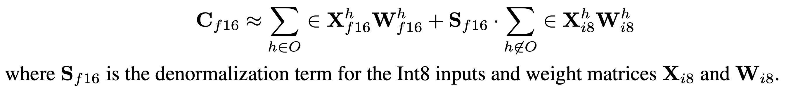
Math

Slide 18
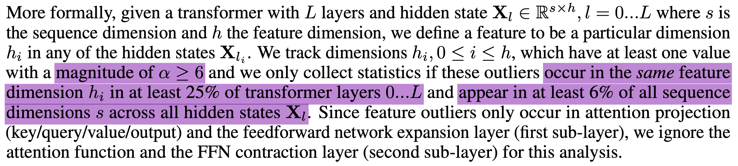
What Is an Outlier?

Slide 19
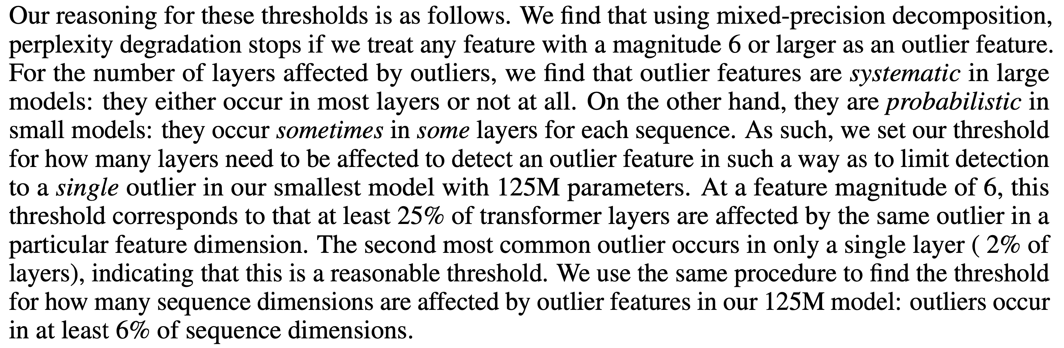
What Is an Outlier

Slide 20
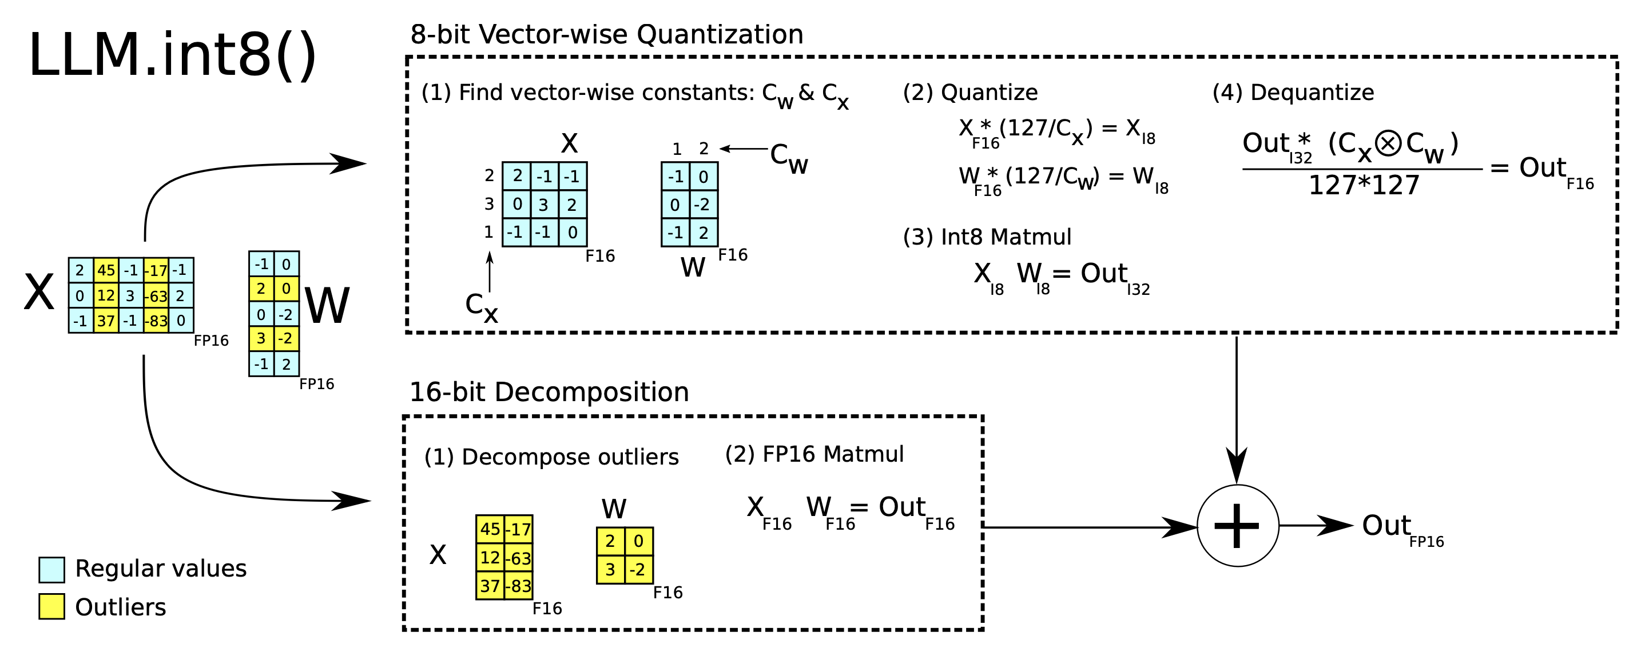
Approach

Slide 21
Experiments

Slide 22
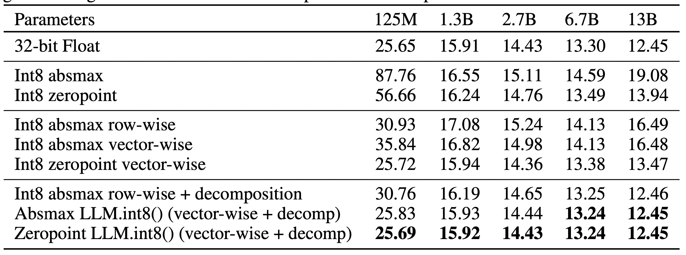
Main Results

Slide 23
Main Results

Slide 24
Main Results

Slide 25
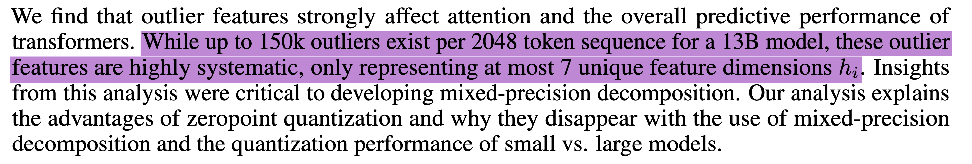
Emergent Large Magnitude Features

Slide 26
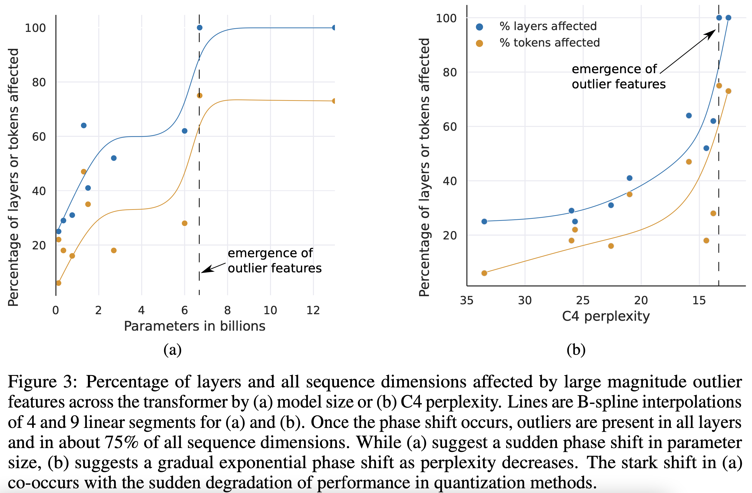
Pct of layers and dimensions affected by outlier features

Slide 27
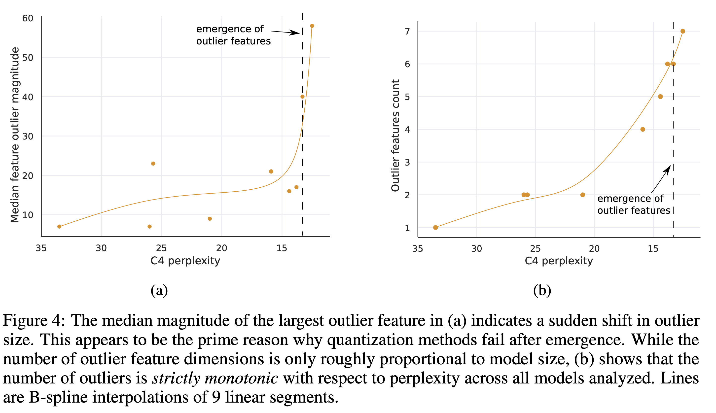
Impact of magnitude and count on performance

Slide 28
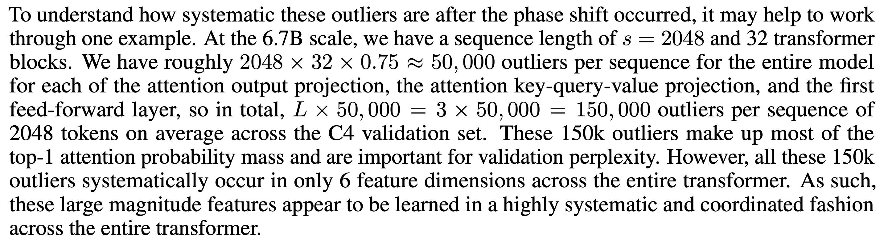
Outliers Are Systematic

Slide 29
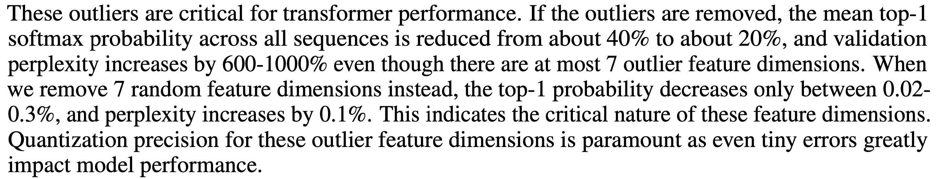
Removing Outliers Impacts Performance

Slide 30
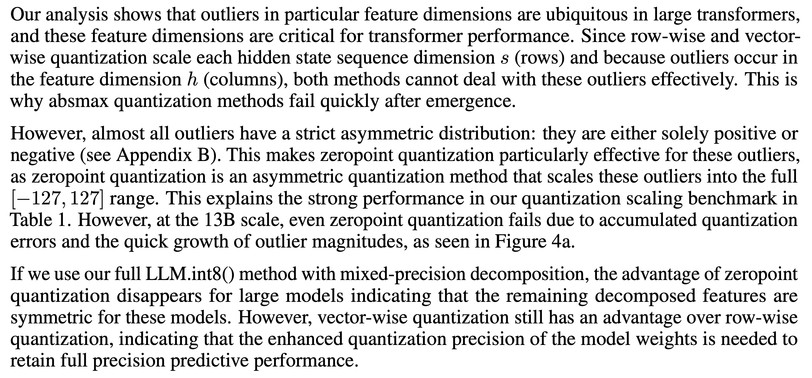
Interpretation

Slide 31
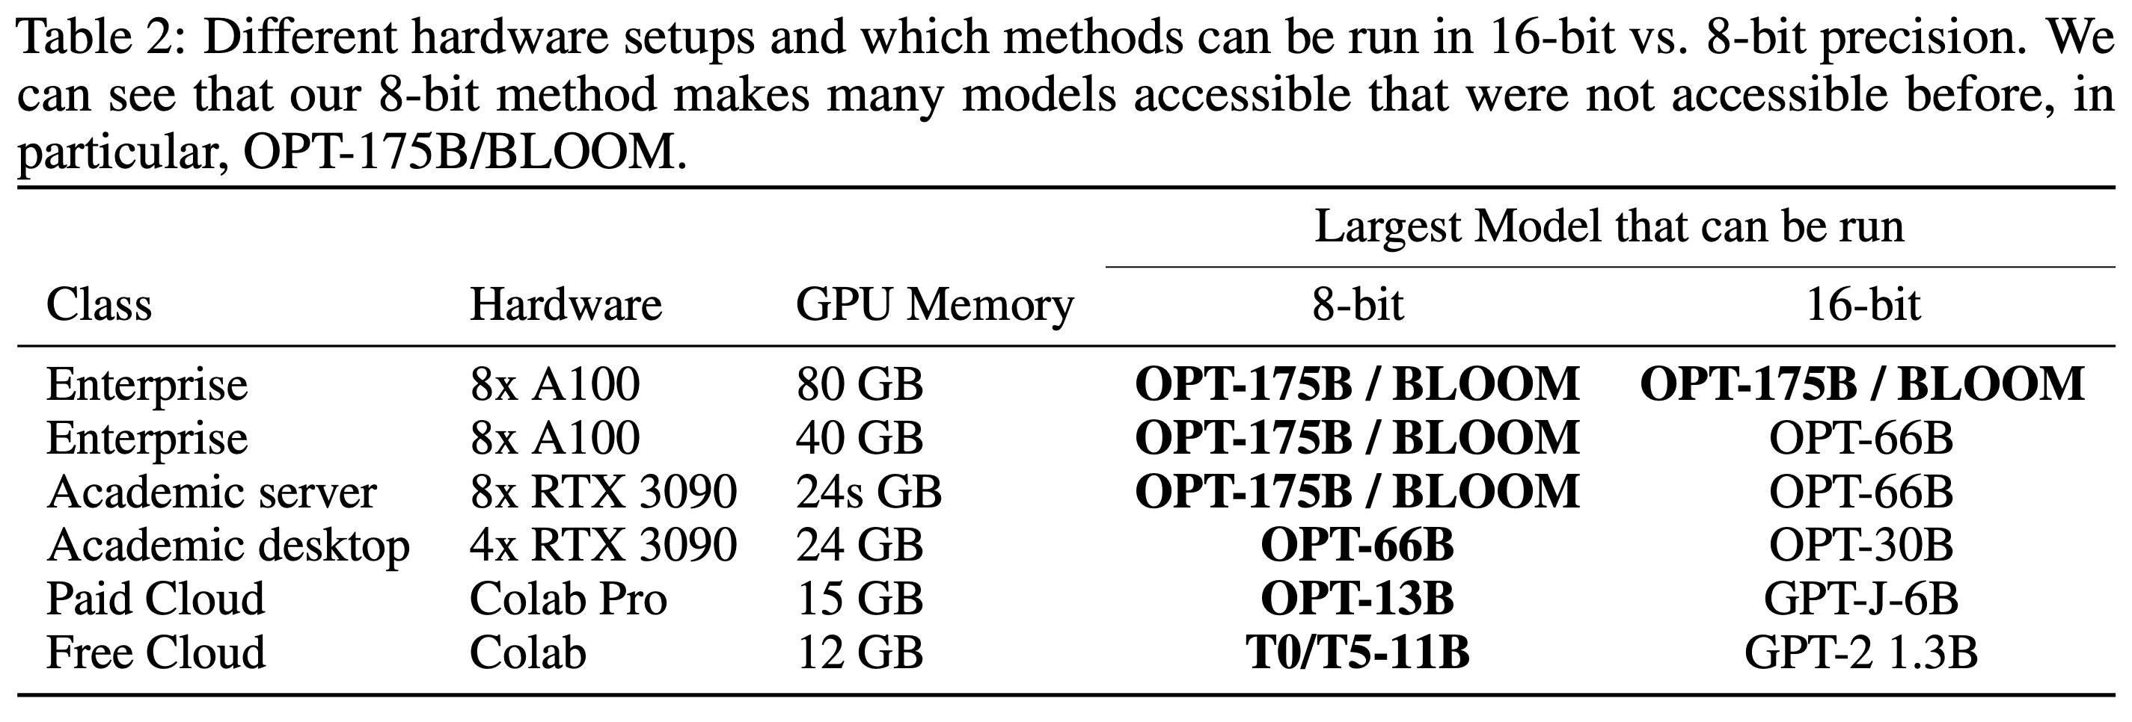
Impact

Slide 32
Thank you!

